Slide 1
Session 10
Collection Framework, java.util interfaces,
Collection types List, Set, and Map

Slide 2
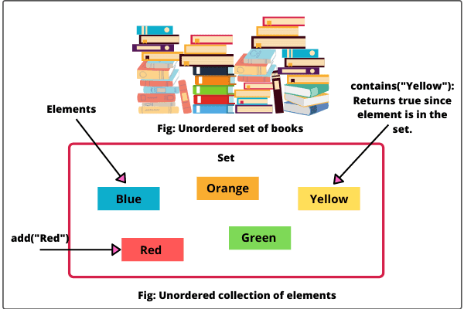
Collection Framework and java.util Package
The Java Collection Framework provides a set of classes and interfaces that help in organizing and manipulating groups of objects.
The java.util package contains several interfaces and classes that represent different types of collections.
These collections facilitate the storage, retrieval, manipulation, and management of data.

Slide 3
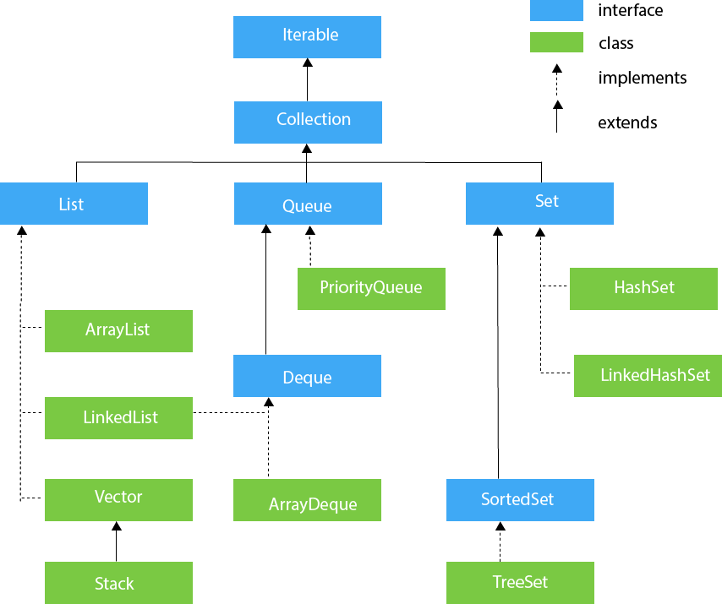
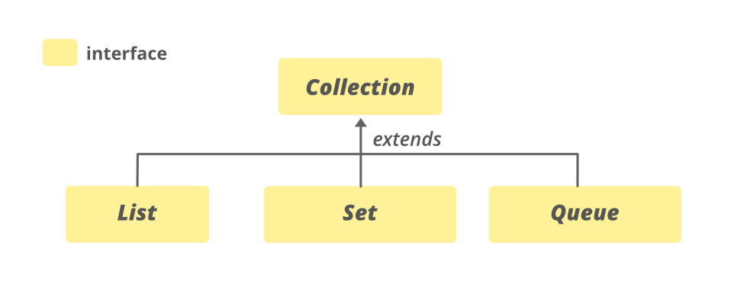
Collection Interface
The Collection interface is the root interface of the Java Collection Framework.
It defines the basic methods common to all collection types, such as add, remove, contains, size, etc.

Slide 4
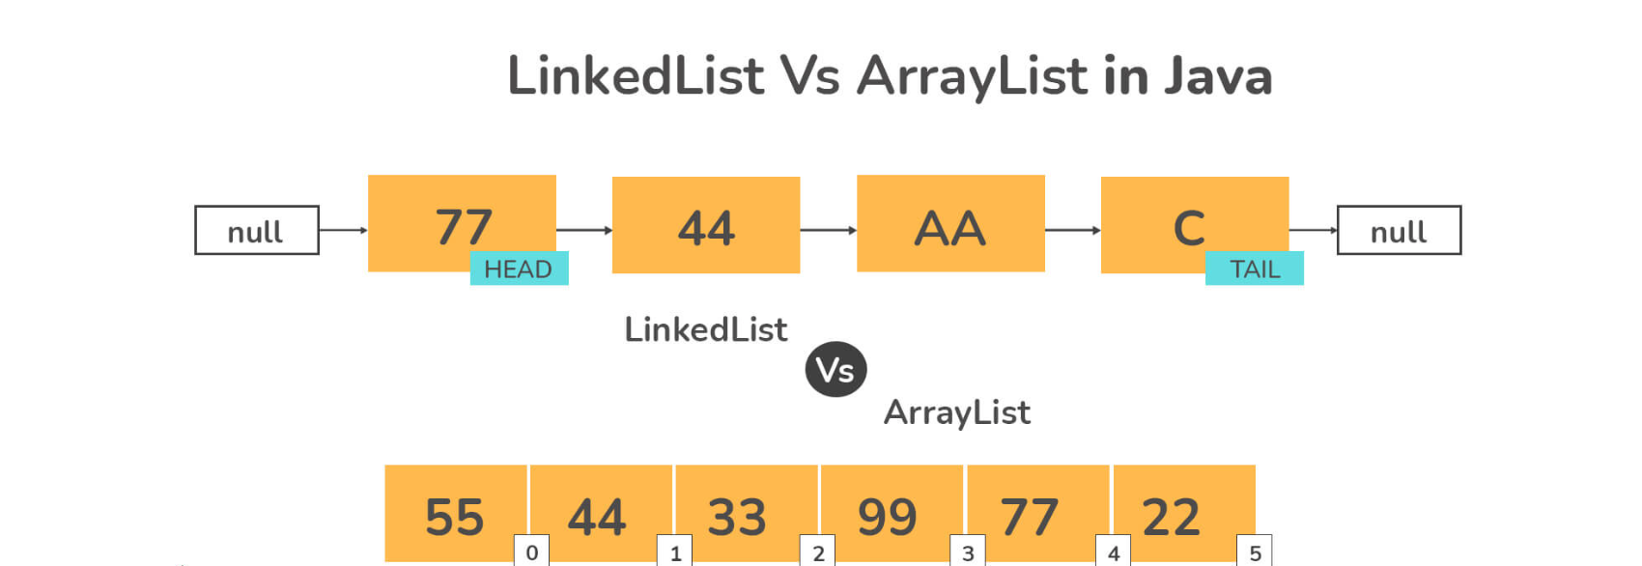
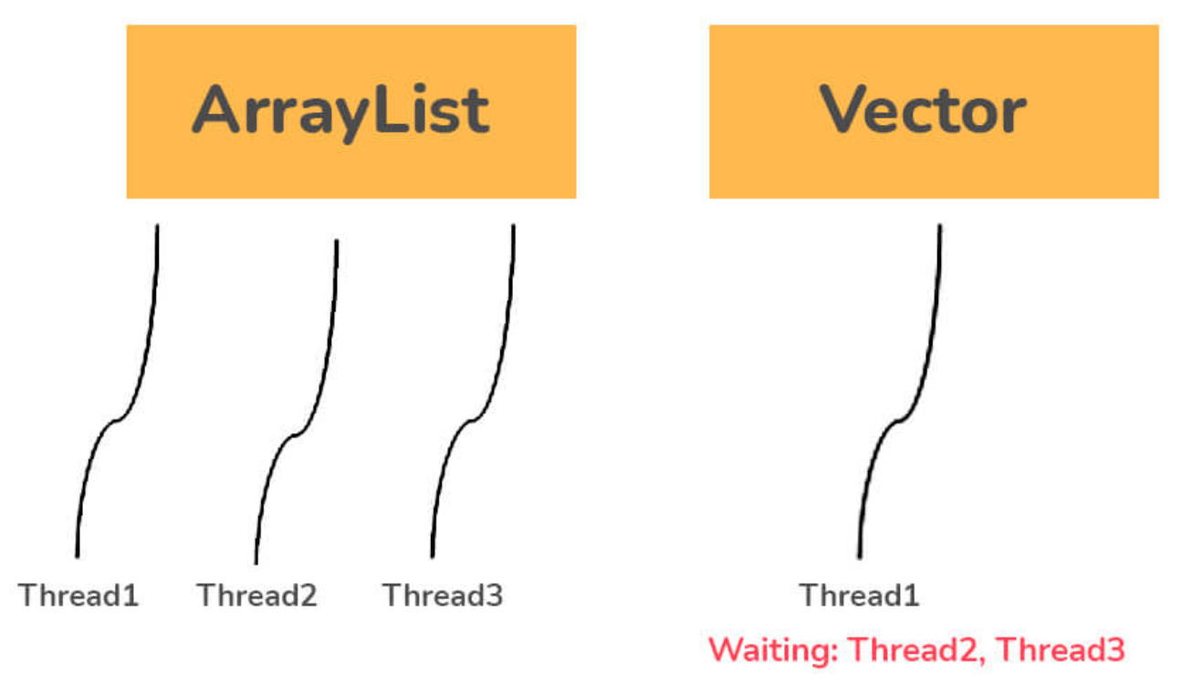
List Interface
The List interface represents an ordered collection of elements that allows duplicate values. Common implementations include ArrayList, LinkedList, and Vector.
Vector is synchronised and thread safe.
import java.util.*; public class ListExample { public static void main(String[] args) { List<String> myList = new ArrayList<>(); myList.add("Apple"); myList.add("Banana"); myList.add("Cherry"); System.out.println("List: " + myList); } }

Slide 5
Set Interface
The Set interface represents a collection of elements that does not allow duplicate values. Common implementations include HashSet, LinkedHashSet, and TreeSet (sorted set).
import java.util.*; public class SetExample { public static void main(String[] args) { Set<Integer> mySet = new HashSet<>(); mySet.add(10); mySet.add(20); mySet.add(30); System.out.println("mySet: " + mySet); } }
import java.util.*;
public class TestJavaCollection9 {
public static void main(String args[]) {
TreeSet<String> set = new TreeSet<String>();
set.add("Ravi");
set.add("Vijay");
set.add("Ravi");
set.add("Ajay");
Iterator<String> itr = set.iterator();
while (itr.hasNext()) {
System.out.println(itr.next());
}
}
}

Slide 6
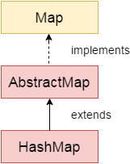
Map Interface
The Map interface represents a collection of key-value pairs, where each key is associated with a unique value. Common implementations include HashMap, LinkedHashMap, and TreeMap.
import java.util.*; public class MapExample { public static void main(String[] args) { Map<String, Integer> myMap = new HashMap<>(); myMap.put("One", 1); myMap.put("Two", 2); myMap.put("Three", 3); System.out.println("Map: " + myMap);
} }

Slide 7
Hash map example 2
import java.util.*;
public class HashMapExample2{
public static void main(String args[]){
HashMap<Integer,String> map=new HashMap<Integer,String>();//Creating HashMap
map.put(1,"Mango"); //Put elements in Map
map.put(2,"Apple");
map.put(3,"Banana");
map.put(1,"Grapes"); //trying duplicate key
System.out.println("Iterating Hashmap...");
for(Map.Entry m : map.entrySet()){
System.out.println(m.getKey()+" "+m.getValue());
}
}
}

Slide 8
Iterator Interface
The Iterator interface provides methods to iterate over elements in a collection. It is used to retrieve elements sequentially and is supported by various collection types.
import java.util.*;
public class IteratorExample {
public static void main(String[] args) {
// Creating an ArrayList
List<String> fruits = new ArrayList<>();
fruits.add("Apple");
fruits.add("Banana");
fruits.add("Cherry");
// Creating an Iterator
Iterator<String> iterator = fruits.iterator();
// Using the Iterator to traverse the ArrayList
System.out.println("Fruits in the ArrayList:");
while (iterator.hasNext()) {
String fruit = iterator.next();
System.out.println(fruit);
}
}
}

Slide 9
Collections Class
The Collections class contains utility methods to operate on collections, such as sorting, searching, and synchronizing.
import java.util.*;
public class CollectionsUtilityExample {
public static void main(String[] args) {
List<Integer> numbers = new ArrayList<>();
numbers.add(5);
numbers.add(2);
numbers.add(8);
numbers.add(1);
numbers.add(9);
// Sorting the list using Collections.sort()
Collections.sort(numbers);
System.out.println("Sorted numbers: " + numbers);
// Searching for an element using Collections.binarySearch()
int searchNumber = 8;
int index = Collections.binarySearch(numbers, searchNumber);
if (index >= 0) {
System.out.println(searchNumber + " found at index " + index);
} else {
System.out.println(searchNumber + " not found");
}
}
}

Slide 10
Comparator Interface
The Comparator interface is used to define custom sorting orders for objects. It is often used with sorting methods in the Collections class.
import java.util.*;
class Student {
private int id;
private String name;
public Student(int id, String name) {
this.id = id;
this.name = name;
}
public int getId() {
return id;
}
public String getName() {
return name;
}
}
class StudentIdComparator implements Comparator<Student> {
@Override
public int compare(Student student1, Student student2) {
return Integer.compare(student1.getId(), student2.getId());
}
}
public class ComparatorExample {
public static void main(String[] args) {
List<Student> students = new ArrayList<>();
students.add(new Student(101, "Alice"));
students.add(new Student(103, "Bob"));
students.add(new Student(102, "Charlie"));
// Sorting the list using a custom comparator
Collections.sort(students, new StudentIdComparator());
System.out.println("Students sorted by ID:");
for (Student student : students) {
System.out.println(student.getId() + ": " + student.getName());
}
}
}

Slide 11
Advantages of Collection Framework
Provides a unified architecture for handling and manipulating groups of objects.
Offers a wide range of collection classes and interfaces tailored for different scenarios.
Improves code reusability and modularity by abstracting data structures.

Slide 12
Example: Using List, Set, and Map
import java.util.*; public class CollectionExample { public static void main(String[] args) { List<String> myList = new ArrayList<>(); myList.add("Apple"); myList.add("Banana"); myList.add("Cherry"); Set<Integer> mySet = new HashSet<>(); mySet.add(10); mySet.add(20); mySet.add(30); Map<String, Integer> myMap = new HashMap<>(); myMap.put("One", 1); myMap.put("Two", 2); myMap.put("Three", 3); System.out.println("List: " + myList); System.out.println("Set: " + mySet); System.out.println("Map: " + myMap); } }

Slide 13
Key points
Collection Framework:
The Collection Framework provides a set of classes and interfaces for managing and organizing groups of objects.
It is located in the java.util package and includes interfaces and classes to work with various collection types.
java.util Interfaces:
1. Collection Interface:
The root interface of the Collection Framework hierarchy.
Defines basic methods common to all collection types, such as add, remove, size, isEmpty, etc.
2. List Interface:
Represents an ordered collection that allows duplicate elements.
Common implementations include ArrayList, LinkedList, and Vector.
3. Set Interface:
Represents an unordered collection that does not allow duplicate elements.
Common implementations include HashSet, LinkedHashSet, and TreeSet.
4. Map Interface:
Represents a collection of key-value pairs, where each key is associated with a unique value.
Common implementations include HashMap, LinkedHashMap, and TreeMap.

Slide 14
Contd…
Collection Types List, Set, and Map:
1. List:
Ordered collection that allows duplicate elements.
Elements are indexed, and you can access them by their index.
Common methods: add, get, set, remove, size.
2. Set:
Unordered collection that does not allow duplicate elements.
Common methods: add, contains, remove, size.
3. Map:
Collection of key-value pairs, where keys are unique identifiers for values.
Common methods: put, get, containsKey, remove, size.
The Collection Framework simplifies the management and manipulation of data collections.
java.util interfaces provide a common contract for different types of collections.
The List interface maintains the order of elements and allows duplicates.
The Set interface ensures unique elements and doesn't guarantee order.
The Map interface stores key-value pairs, and keys must be unique.
Each interface has multiple implementations with different characteristics.
The framework provides utility classes like Collections for common operations.
Custom sorting can be achieved using the Comparator interface.
Interview questions : https://www.interviewbit.com/java-collections-interview-questions/

